Slide 1
ENVIRONMENTAL STATISTICS
STATISTICS DIVISION
Regional Seminar on the System of Environmental-Economic Accounting (SEEA) Central Framework in the Caribbean
Regional Strategy for the implementation of SEEA: key features and reflections for the Caribbean

Slide 2
ENVIRONMENTAL STATISTICS
Statistics Division
Objective
Share the experience of developing a regional strategy for the implementation of SEEA in Latin America along with its key features and reflections for advancing in the Caribbean

Slide 3
ENVIRONMENTAL STATISTICS
Statistics Division
Developing a regional SEEA strategy for Latin America
Main reference: global SEEA strategy
The following elements were taken into consideration:
Degree of development of the System of National Accounts
Degree of development of basic environmental statistics
Analysis of institutional frameworks and arrangements of national statistics systems
Challenges (interviews with experts)
Willingness of statistical community to adopt the SEEA
Literature review on the state of the art
Regional consultation of draft strategy (18 inst from10 countries)

Slide 4
ENVIRONMENTAL STATISTICS
Regional and national level
Statistics Division
Producers
NSO
Ministry of Environment
Central Bank
Stakeholders
Ministries of
Planning
Finance and Economy
Agriculture
Energy
Environment
Mineral Resources etc.
1
SEEA promotion
Users
2
National priorities
3
Institutional Arrangements
4
Data availability and quality assessment
5
National SEEA implementation plans
Notes:
En Fase 1 es crucial determinar los stakeholders desde el lado de la demanda para lograr que la información procesada en el lado de la oferta (INE, bancos centrales, ministerios de ambiente…) sera útil y necesaria

Slide 5
Setting National priorities:
A national plan of implementation prioritizes the SEEA tables and accounts to be produced in the short to medium term based on most pressing policy demands.
To identify priorities and ensure the relevance and use of the accounts “users” must participate in the process from the beginning.
Users
Social demands
Climate change
Pollution
Water: scarcity, intensity
Energy: scarcity, dependence
Resource Productivity
Deforestation / degradation
Natural resources management
Effectiveness of policy instruments
SEEA
Physical and hybrid flow accounts
Asset accounts
Env. activities accounts
Waste
Land cover
Minerals and energy assets
Environmental Taxes and subsidies
Air emissions
Water emissions
Water flows
Energy and material
EPEA
Forest
Water stocks
EGSS
Producers
Statistical sources
Emission inventory
Water statistics
Energy statistics
Waste statistics
Land and forest statistics
National Accounts
International trade statistics
Business statistics
Government finance statistics
Administrative data
This interaction between users and producers helps identify the real pressing needs of public policy…
… and makes SEEA essential for measuring environmental sustainability.
Notes:
The second step seeks to define, in the users perspective, the national priorities of environmental-economic tables, statistics and indicators. The main users of the SEEA information are policy makers (energy, water, agriculture, industry, mining, transportation and environment ministries) and government planning staff.
What is important at this point is to make an approach of what is really important from the user’s side, so that the outputs of the compilation of environmental-economics statistics be socially neccesary.

Slide 6
ENVIRONMENTAL STATISTICS
Statistics Division
National implementation plan
A document that lays out:
National policy priorities
Link to NSDS and also national development strategies
Tables and accounts to be produced
Commitments and institutional arrangements
Define roles and responsibilities
Who will lead the production of the accounts
High level “”sponsor” or “owner” of the process
Results of the data assessment (identify data gaps)
Budget and resources needed
Timeline

Slide 7
ENVIRONMENTAL STATISTICS
Statistics Division
Key features of the strategy
Recognises the heterogeneous statistical development of countries in the region
Flexible
Modular and gradual approach
Demand-driven
Users play a key role in the process
Participatory
Calls for greater coordination at national, regional and global levels
Promotes south-south cooperation
Makes provisions for training and capacity building (technical and institutional)

Slide 8
ENVIRONMENTAL STATISTICS
Statistics Division
Regional program to advance the implementation of the SEEA strategy
Main components:
Raise awareness on SEEA 2012 at regional and national levels
Support countries to elaborate national SEEA implementation plans
Provide a mechanism of financing, training and technical assistance to countries to implement national plans

Slide 9
ENVIRONMENTAL STATISTICS
Statistics Division
Reflections for the Caribbean region
Report of the Standing Committee of Caribbean Statisticians noted the following:
Focus efforts on the basic data series in National Accounts and specifically on the Minimum Required Data Set.
More work needs to be done to fill data gaps on waste, water, land use and air.
Workshops on SEEA should be combined with training on basic environmental statistics

Slide 10
ENVIRONMENTAL STATISTICS
Statistics Division
Reflections for the Caribbean region
A regional strategy for the Caribbean must be tailored to the priorities, conditions and statistical development of the countries.
Advances in the implementation of SNA 2008 and SEEA need to go hand in hand.
Advancing the SNA 2008 will prepare the ground for SEEA (for example the development of SUTs).
The SEEA can be used to strengthen basic environmental statistics on important policy issues such as water.

Slide 11
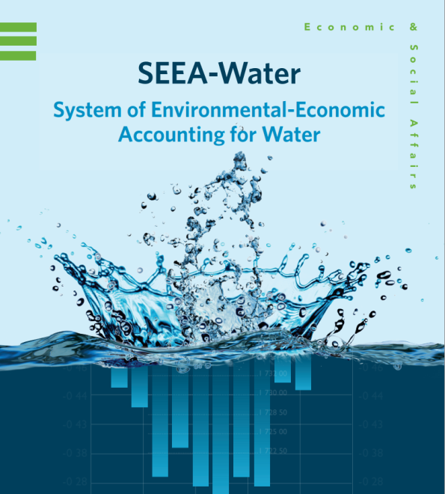
ENVIRONMENTAL STATISTICS
Statistics Division
Under development
Guidelines for the compilation of water statistics and accounts
In 2010 the Statistical Commission adopted the IRWS, designed to support countries in the collection, compilation and dissemination of internationally comparable water statistics
Practical material to help countries compile stats and accounts

Slide 12
ENVIRONMENTAL STATISTICS
Statistics Division
Opportunities to make progress
Pilots for implementing the SEEA 2012 (St. Lucia and Jamaica)
CARICOM’s statistical program on SNA and environmental statistics
Implementation of FDES
Several initiatives are underway or being set up:
Regional Public Goods project on environmental statistics (Bahamas, Belize, Jamaica and Surinam)
ECLAC project on advancing the SNA 2008 and SEEA 2012.
Several GEF projects on environmental information.
UNDP interest in supporting implemention of SEEA
Others….

Slide 13
ENVIRONMENTAL STATISTICS
Statistics Division
Way forward
Create synergies among the different initiatives taking place.
Strengthen coordination among agencies and countries.
Important not to loose momentum…
Plan follow up (awareness raising, high level involvement in defining policy priorities and political support, review institutional arrangements, get commitments and define responsibilities, in-depth data assessment, national implementation plan……..)

Slide 14
ENVIRONMENTAL STATISTICS
Statistics Division
Thank you
For more information contact
Kristina.taboulchanas@cepal.org

